Slide 1
R Programming for Statistical Analysis
Day 1 Session 1
‘Understanding the Rstudio Layout and Workflow’
Presenter: Hammed Akande

Slide 2
Learning objectives
Know how to Download and Install
Install and load R Packages
Understand R layout/workflow
Understand difference between R Script & Markdown

Slide 3
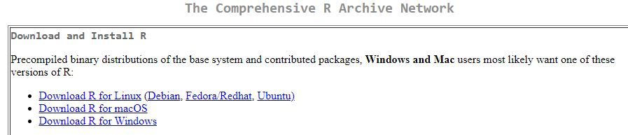
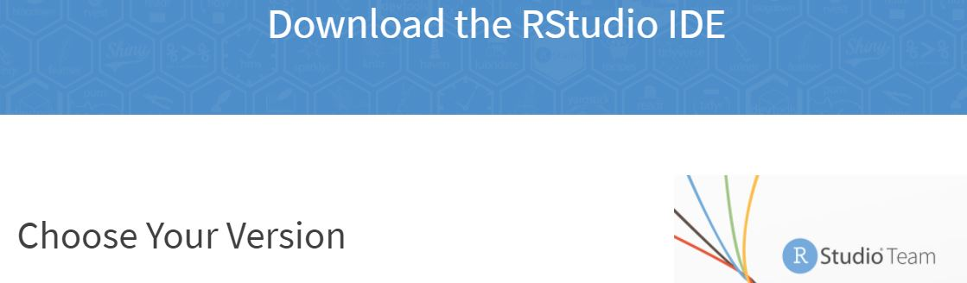
Download R and Rstudio
Go to CRAN website (https://cran.r-project.org/)
For R Studio- (https://www.rstudio.com/products/rstudio/download/).

Slide 4
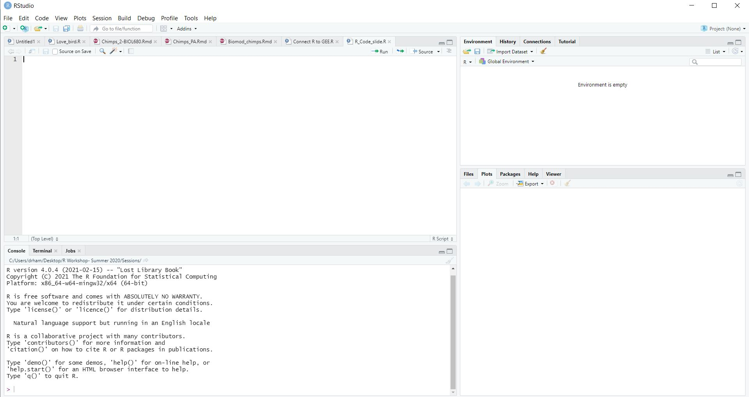
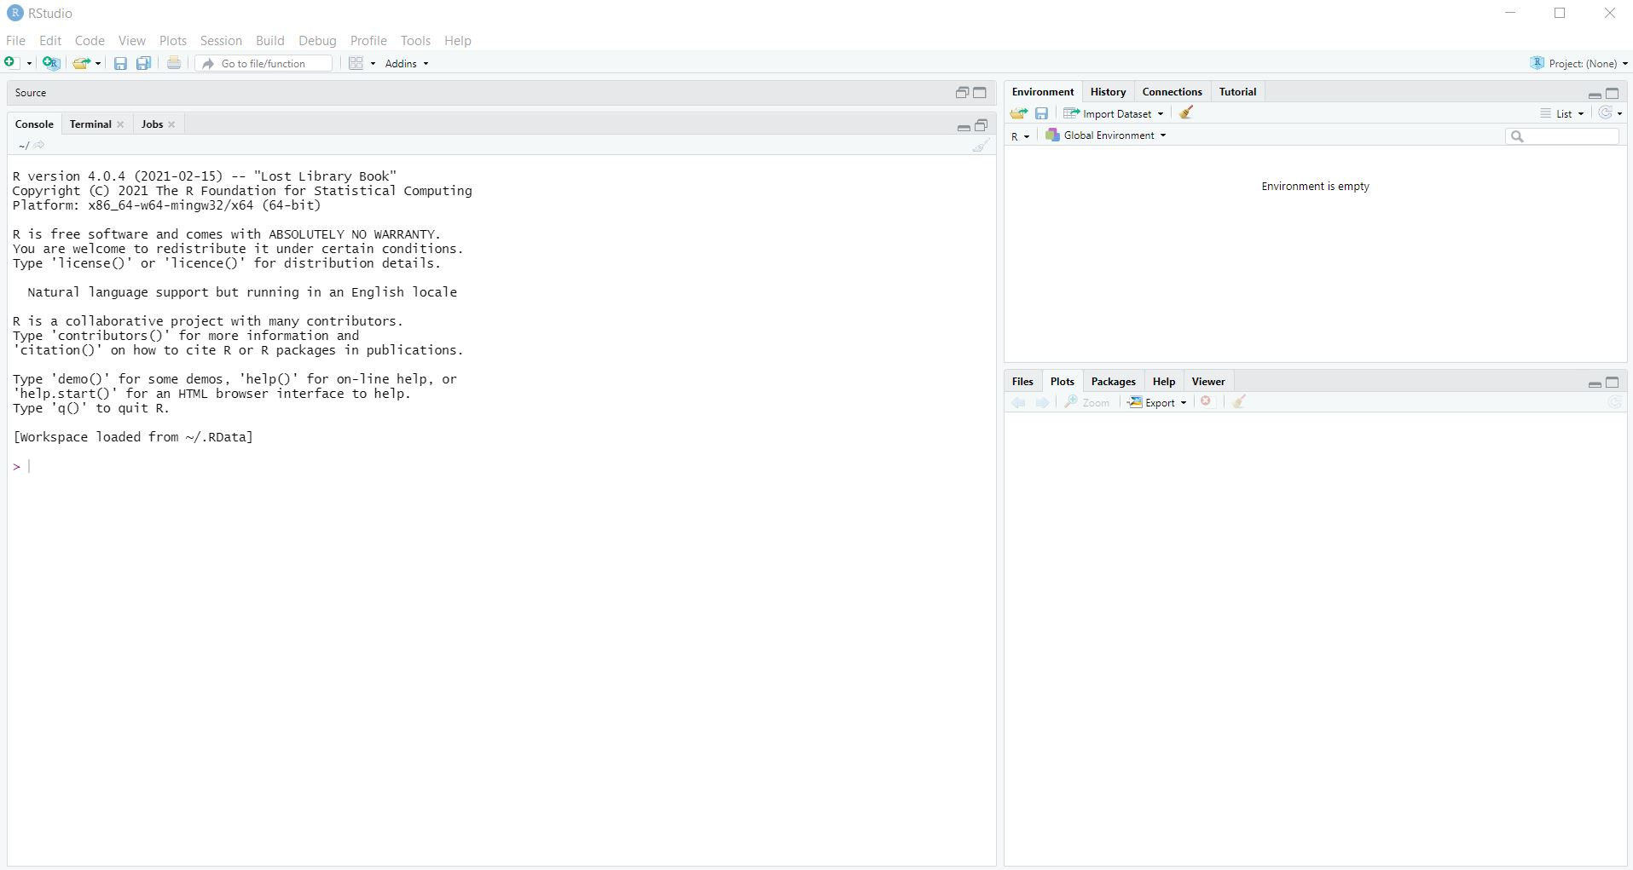
RStudio Layout

Slide 5
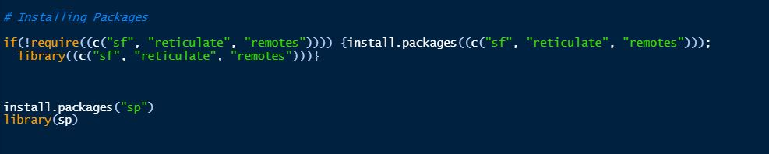
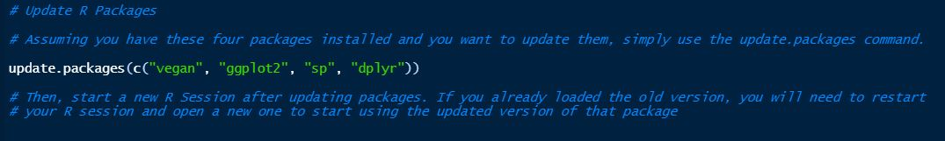
Installing Packages

Slide 6
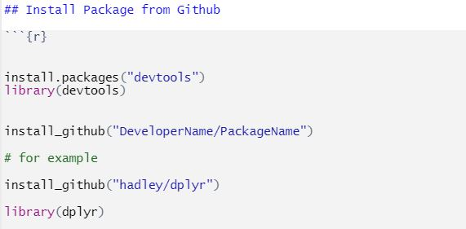
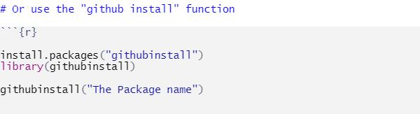
Installing from Github

Slide 7
R Script and R Markdown
R Script can only allow you to add code and comment text
R Markdown offers more flexibility and you can author webpages.
You can “Knit” R Markdown document and publish as HTML, Pdf, and doc format. This will generate webpage (in case of HTML) and output of embedded R code (e.g., plot or image) which makes it easy to share and publish the work).

Slide 8
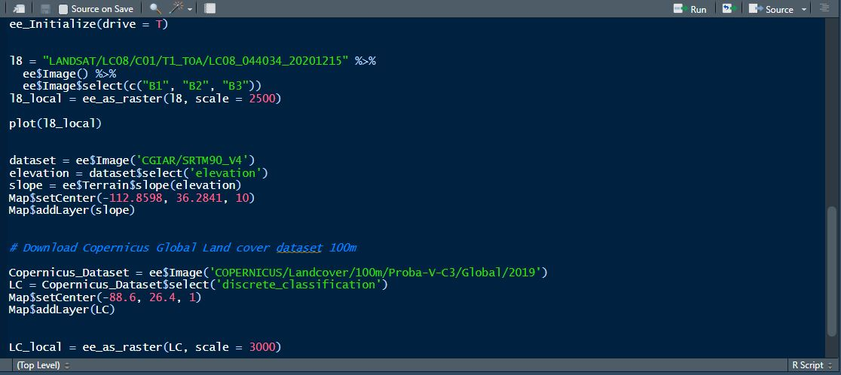
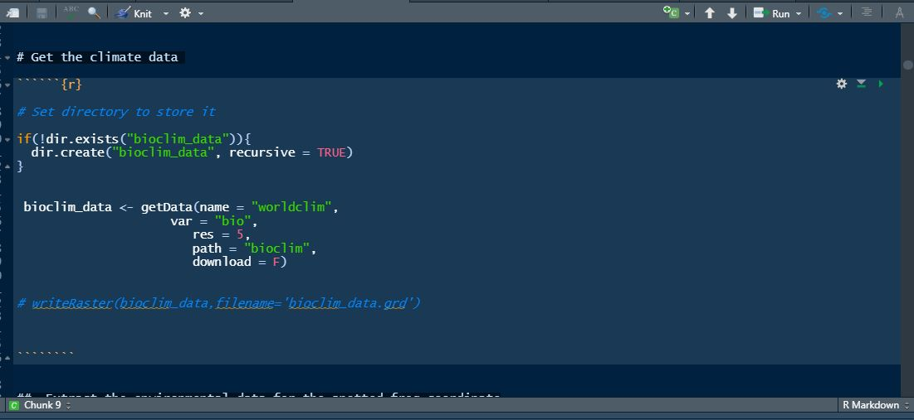
R Script and R Markdown

Slide 9
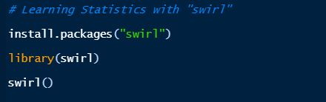
Learning R through SWIRL
If you are fully new to R, you may want to try SWIRL (Statistics with interactive R learning).
This package enables you to learn stat and R commands interactively.
You can type the commands below in your RStudio to get started. Press Enter or Return after each line of code as necessary

Slide 10
Getting help in R and Resources
Google!!!
Use the ? before any function to get documentation about it
Press Alt + Shift + K (on a windows computer) to see all keyboard shortcut
Option + Shift + K (on a Mac computer)
Stack overflow - https://stackoverflow.com/
R-bloggers - https://www.r-bloggers.com/
Tutorial for beginners- https://www.pluralsight.com/search?q=R

